Slide 1
Belinda Chang / Haena Lee / Ming Hui Lin / Senjal Pandharpatte

Slide 2
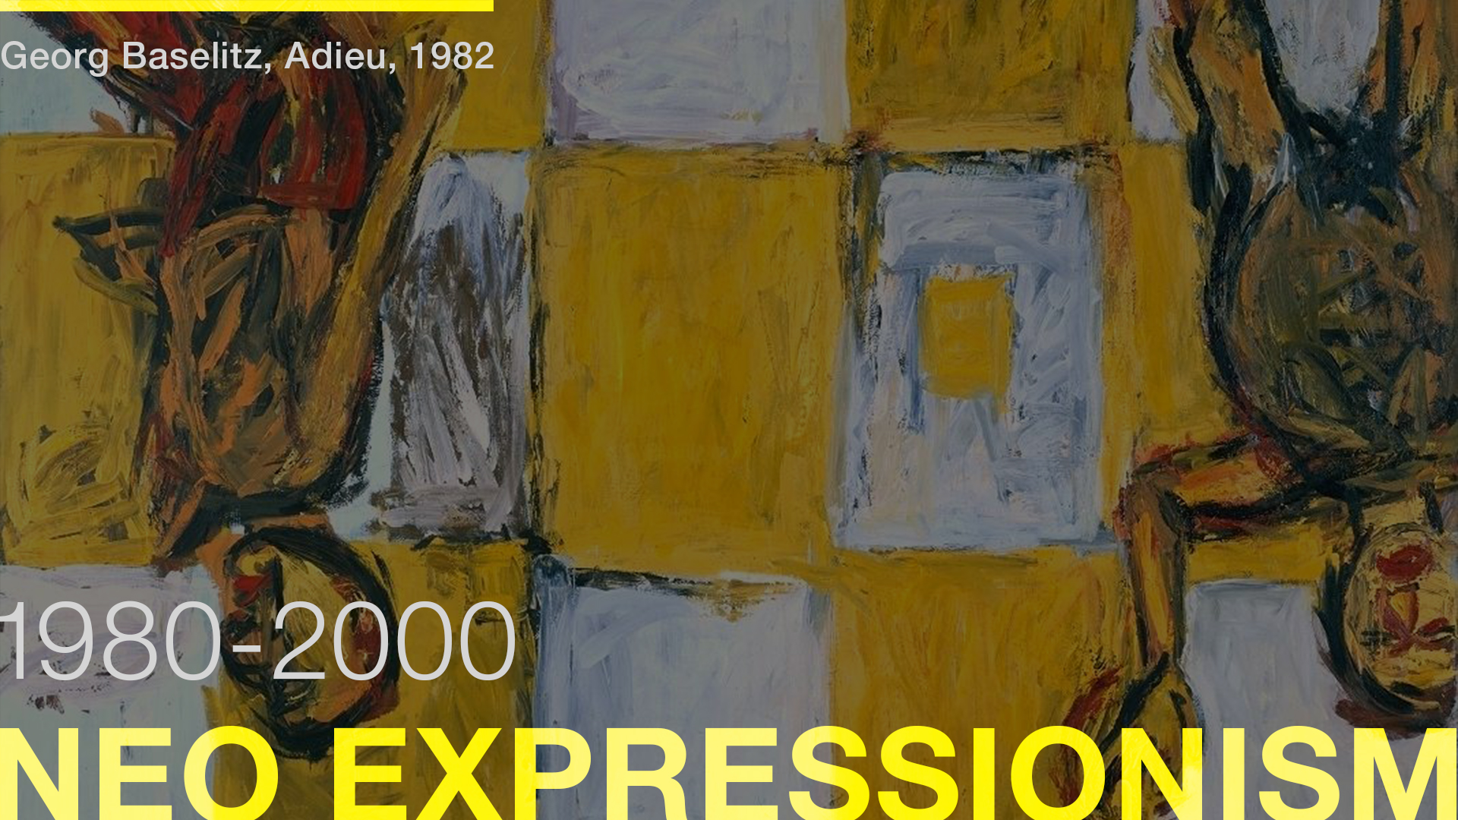
Belinda Chang / Haena Lee / Ming Hui Lin / Senjal Pandharpatte
1980
NEO EXPRESSIONISM
NEO CONCEPTUALISM
ENVIONMENTAL ART
1981
MPMPHIS GROUP
THE INTRODUCTION OF PC
ART MARKET RISE
LAUNCH OF MTV
1982
EMOTICON
1983
3D PRINTER
WORLD WIDE WEB
1985
NINTENDO
DIGITAL DESIGN
1987
CULTURE WARS

Slide 3
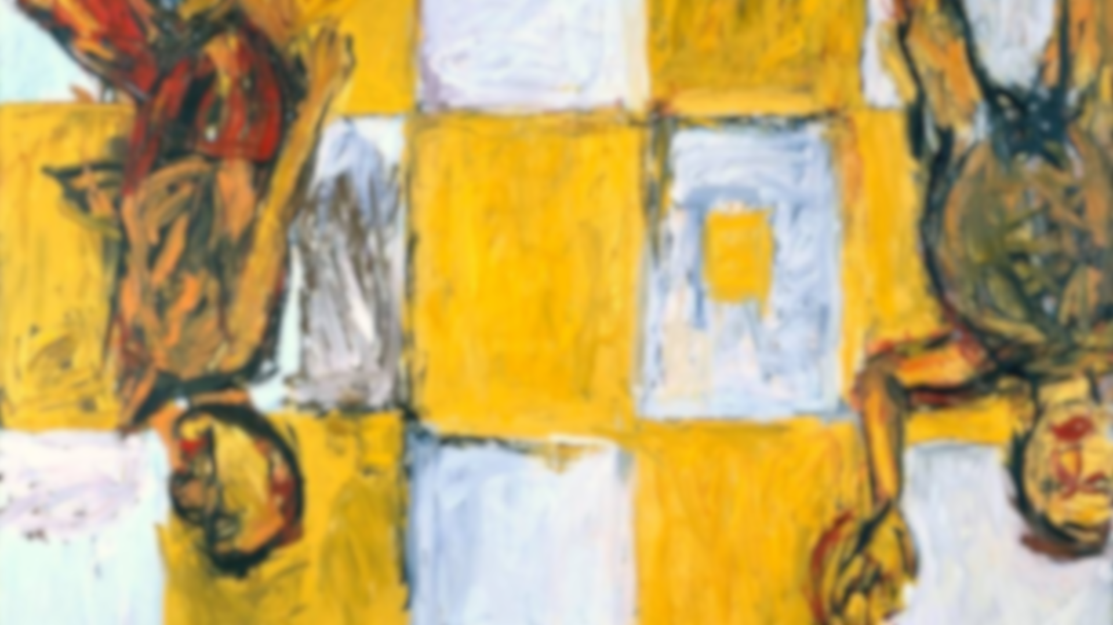
The Neo-Expressionist artists depicted their subjects in an almost raw and brutish manner, newly resurrecting in their frequently large-scale works, the highly textural and expressive brushwork and intense colors that had been rejected by the immediately preceding art movements.

Slide 4
From Modernism to Postmodernism
Because the work of the Neo-Expressionist artists was so closely linked to buying, selling, and the commercial system of art with its galleries, critics, and media hype (typical of the Reagan era in the United States), some in the field began to question its authenticity as art.

Slide 5
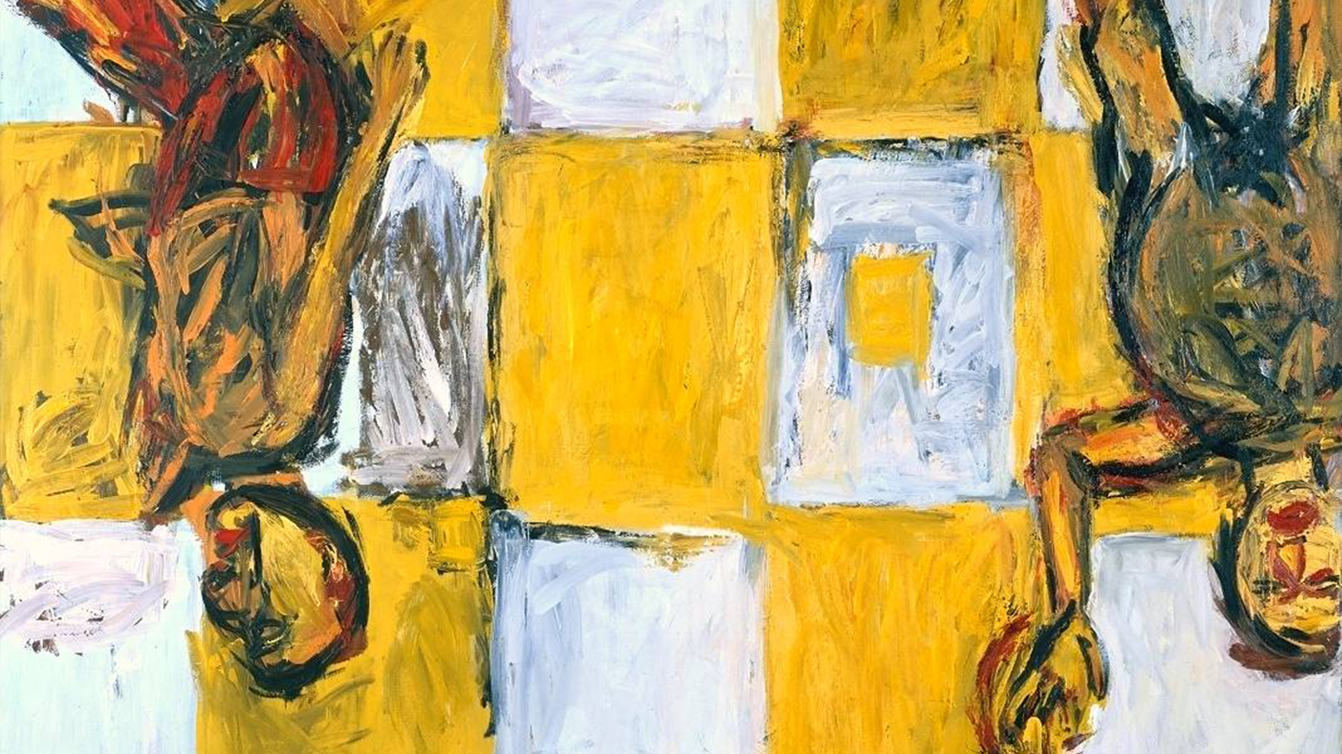

Slide 6
Intro
1980
NEO EXPRESSIONISM
NEO CONCEPTUALISM
ENVIONMENTAL ART
1981
MPMPHIS GROUP
THE INTRODUCTION OF PC
ART MARKET RISE
LAUNCH OF MTV
1982
EMOTICON
1983
3D PRINTER
WORLD WIDE WEB
1985
NINTENDO
DIGITAL DESIGN
1987
CULTURE WARS

Slide 7
A movement or style in which emphasis is given to the concept behind a work of art, frequently through the use of unconventional or incongruous media and often in an ironic or shocking manner. These artists incorporated ready-made objects drawn directly from the commercial realm into their sculptures and installations.

Slide 8
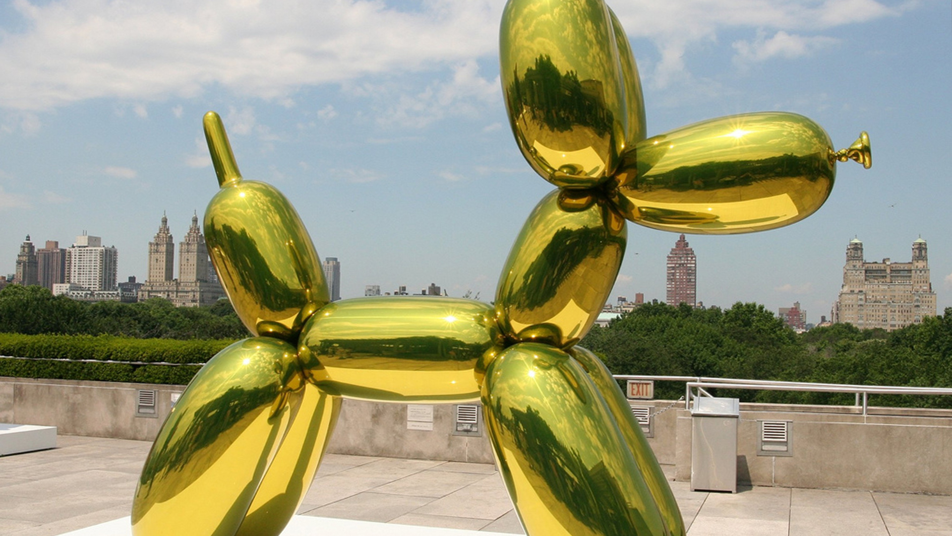

Slide 9
1980
NEO EXPRESSIONISM
NEO CONCEPTUALISM
ENVIONMENTAL ART
1981
MPMPHIS GROUP
THE INTRODUCTION OF PC
ART MARKET RISE
LAUNCH OF MTV
1982
EMOTICON
1983
3D PRINTER
WORLD WIDE WEB
1985
NINTENDO
DIGITAL DESIGN
1987
CULTURE WARS

Slide 10
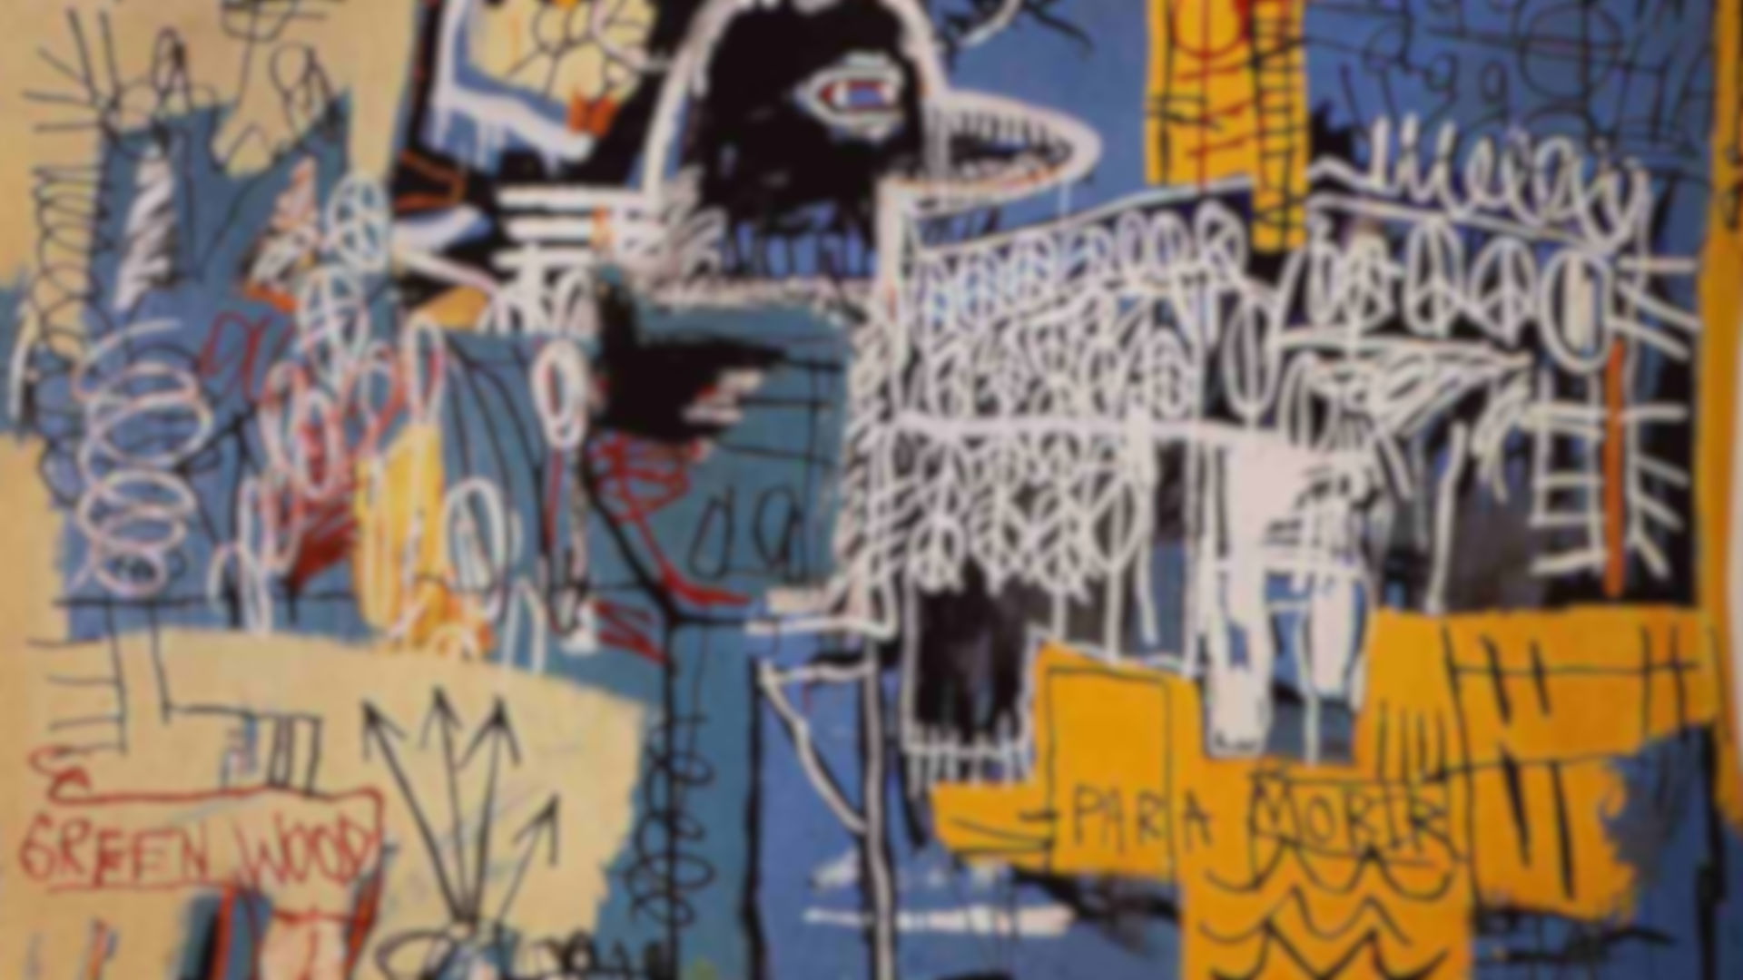
Graffiti

Slide 11
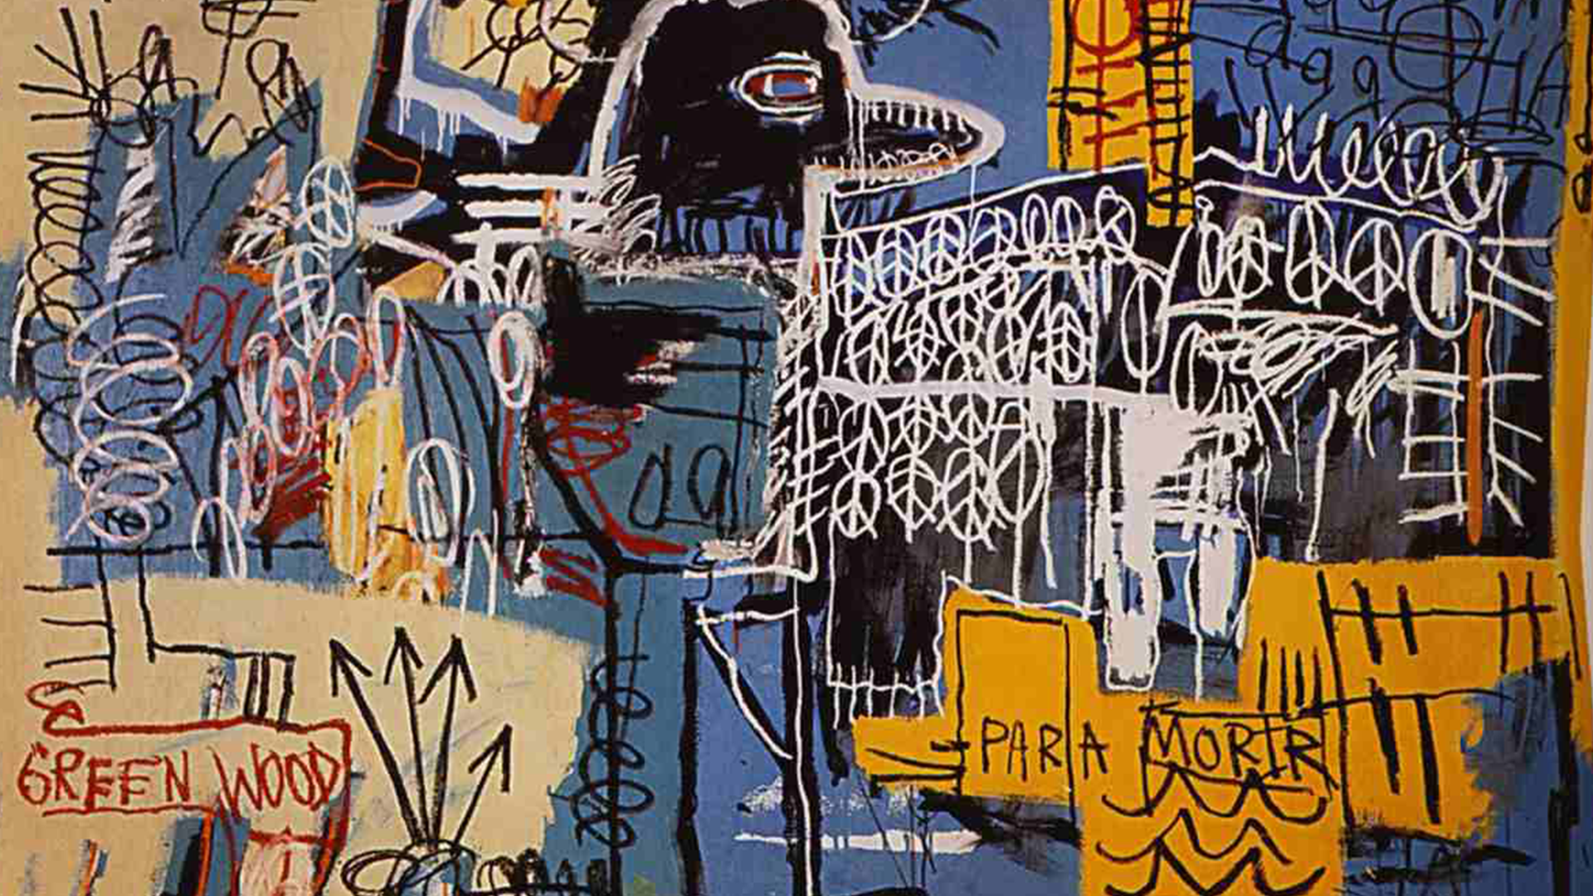

Slide 12
1980
NEO EXPRESSIONISM
NEO CONCEPTUALISM
ENVIONMENTAL ART
1981
MPMPHIS GROUP
THE INTRODUCTION OF PC
ART MARKET RISE
LAUNCH OF MTV
1982
EMOTICON
1983
3D PRINTER
WORLD WIDE WEB
1985
NINTENDO
DIGITAL DESIGN
1987
CULTURE WARS

Slide 13
Founded in Milan by Ettore Sottsass in 1981 that designed Post Modern furniture, fabrics, ceramics, glass and metal objects

Slide 14
Founded in Milan by Ettore Sottsass in 1981 that designed Post Modern furniture, fabrics, ceramics, glass and metal objects
1980
NEO EXPRESSIONISM
NEO CONCEPTUALISM
ENVIONMENTAL ART
1981
MPMPHIS GROUP
THE INTRODUCTION OF PC
ART MARKET RISE
LAUNCH OF MTV
1982
EMOTICON
1983
3D PRINTER
WORLD WIDE WEB
1985
NINTENDO
DIGITAL DESIGN
1987
CULTURE WARS

Slide 15
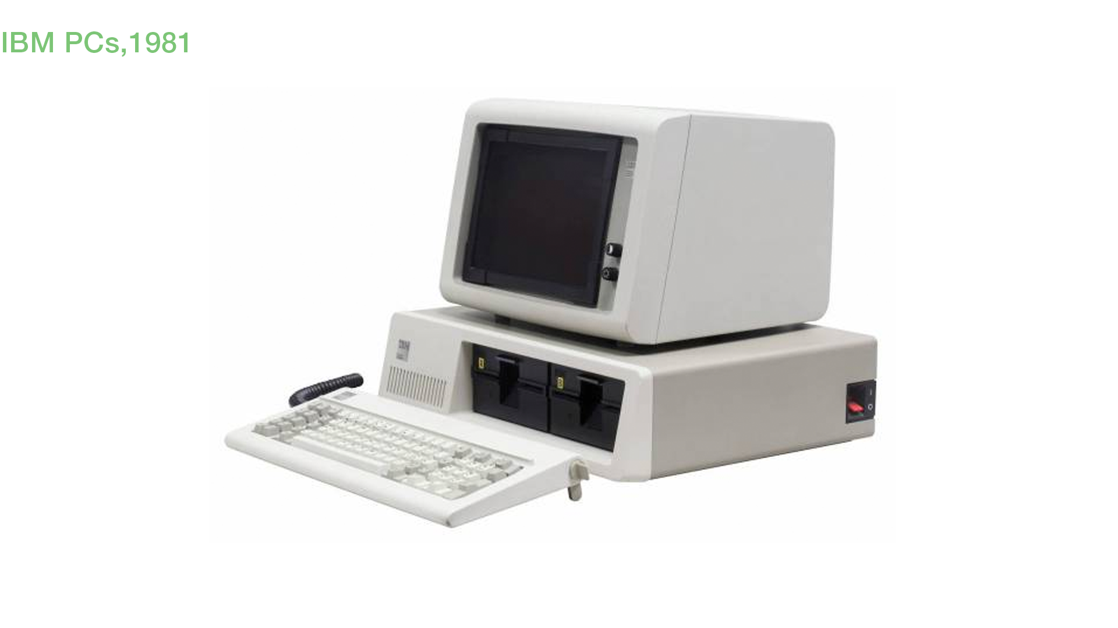
1980
NEO EXPRESSIONISM
NEO CONCEPTUALISM
ENVIONMENTAL ART
1981
MPMPHIS GROUP
THE INTRODUCTION OF PC
ART MARKET RISE
LAUNCH OF MTV
1982
EMOTICON
1983
3D PRINTER
WORLD WIDE WEB
1985
NINTENDO
DIGITAL DESIGN
1987
CULTURE WARS
IBM PCs, 1981

Slide 16
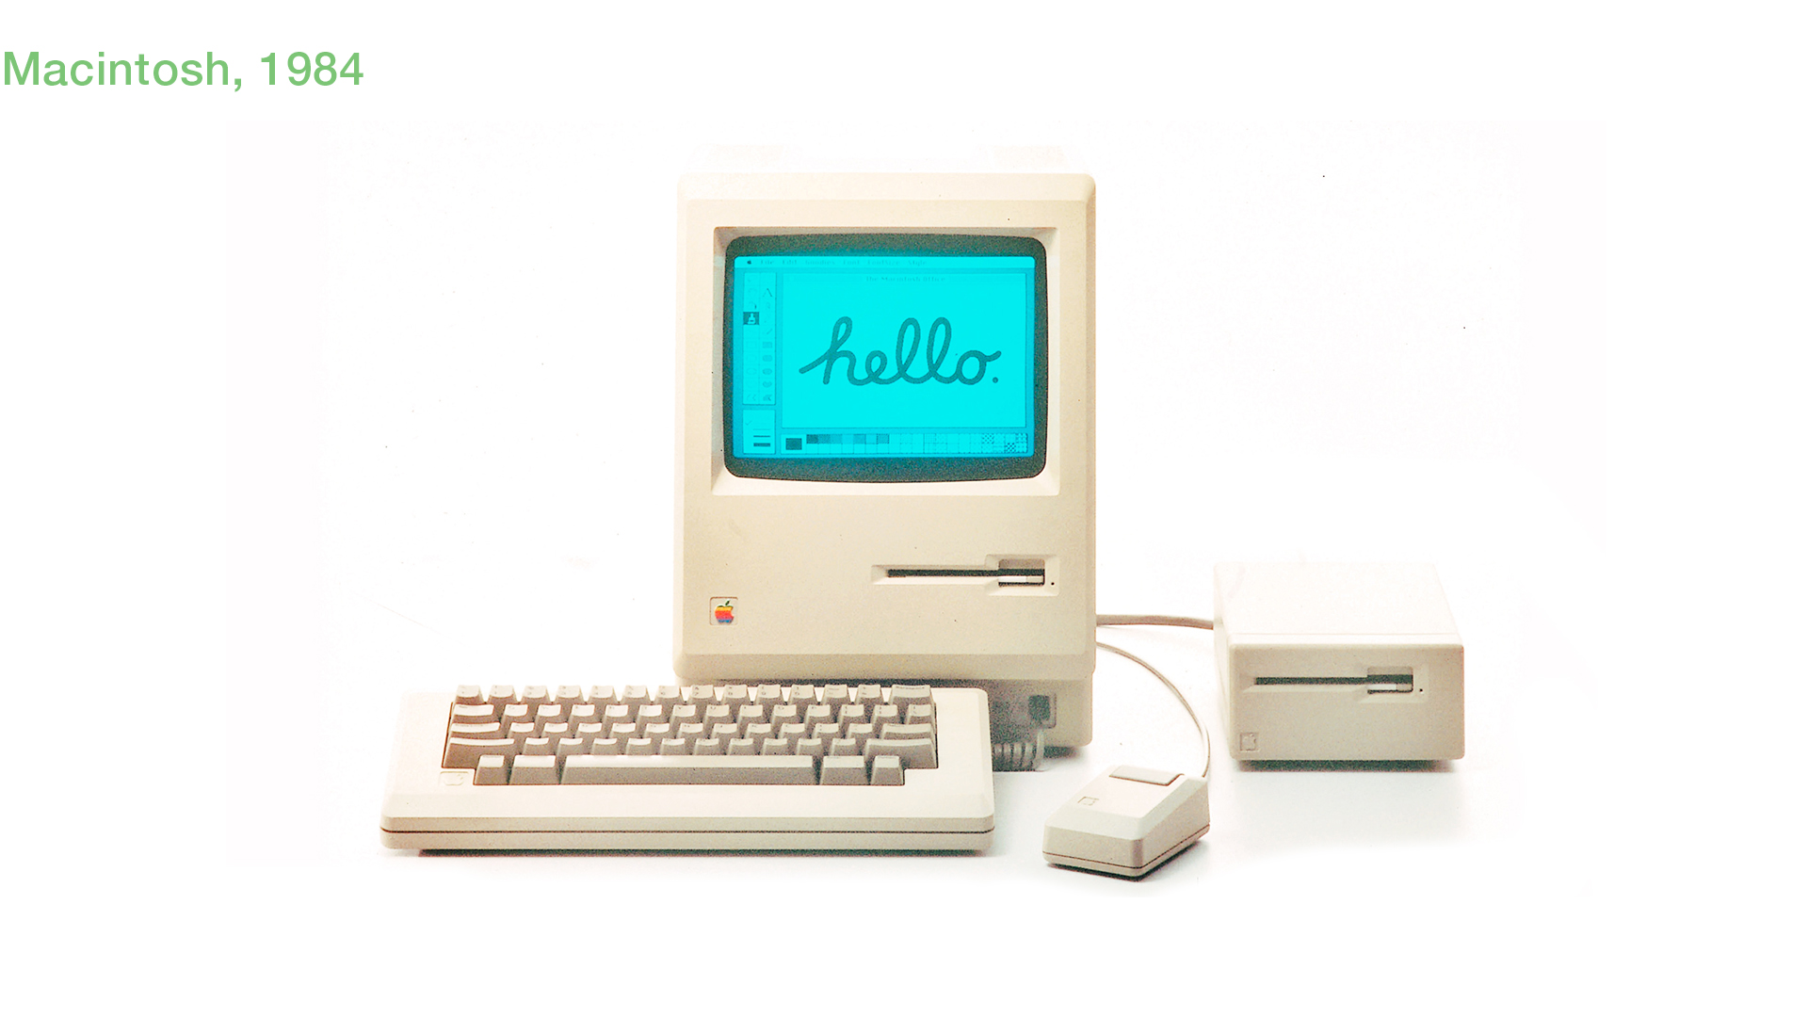
IBM PCs, 1981
Macintosh, 1984
Macintosh changed the face of computing by introducing the mouse and Graphical User Interface (GUI), which can be used by non-technical people.

Slide 17
Macintosh, 1984
Macintosh changed the face of computing by introducing the mouse and Graphical User Interface (GUI), which can be used by non-technical people.
1980
NEO EXPRESSIONISM
NEO CONCEPTUALISM
ENVIONMENTAL ART
1981
MPMPHIS GROUP
THE INTRODUCTION OF PC
ART MARKET RISE
LAUNCH OF MTV
1982
EMOTICON
1983
3D PRINTER
WORLD WIDE WEB
1985
NINTENDO
DIGITAL DESIGN
1987
CULTURE WARS

Slide 18
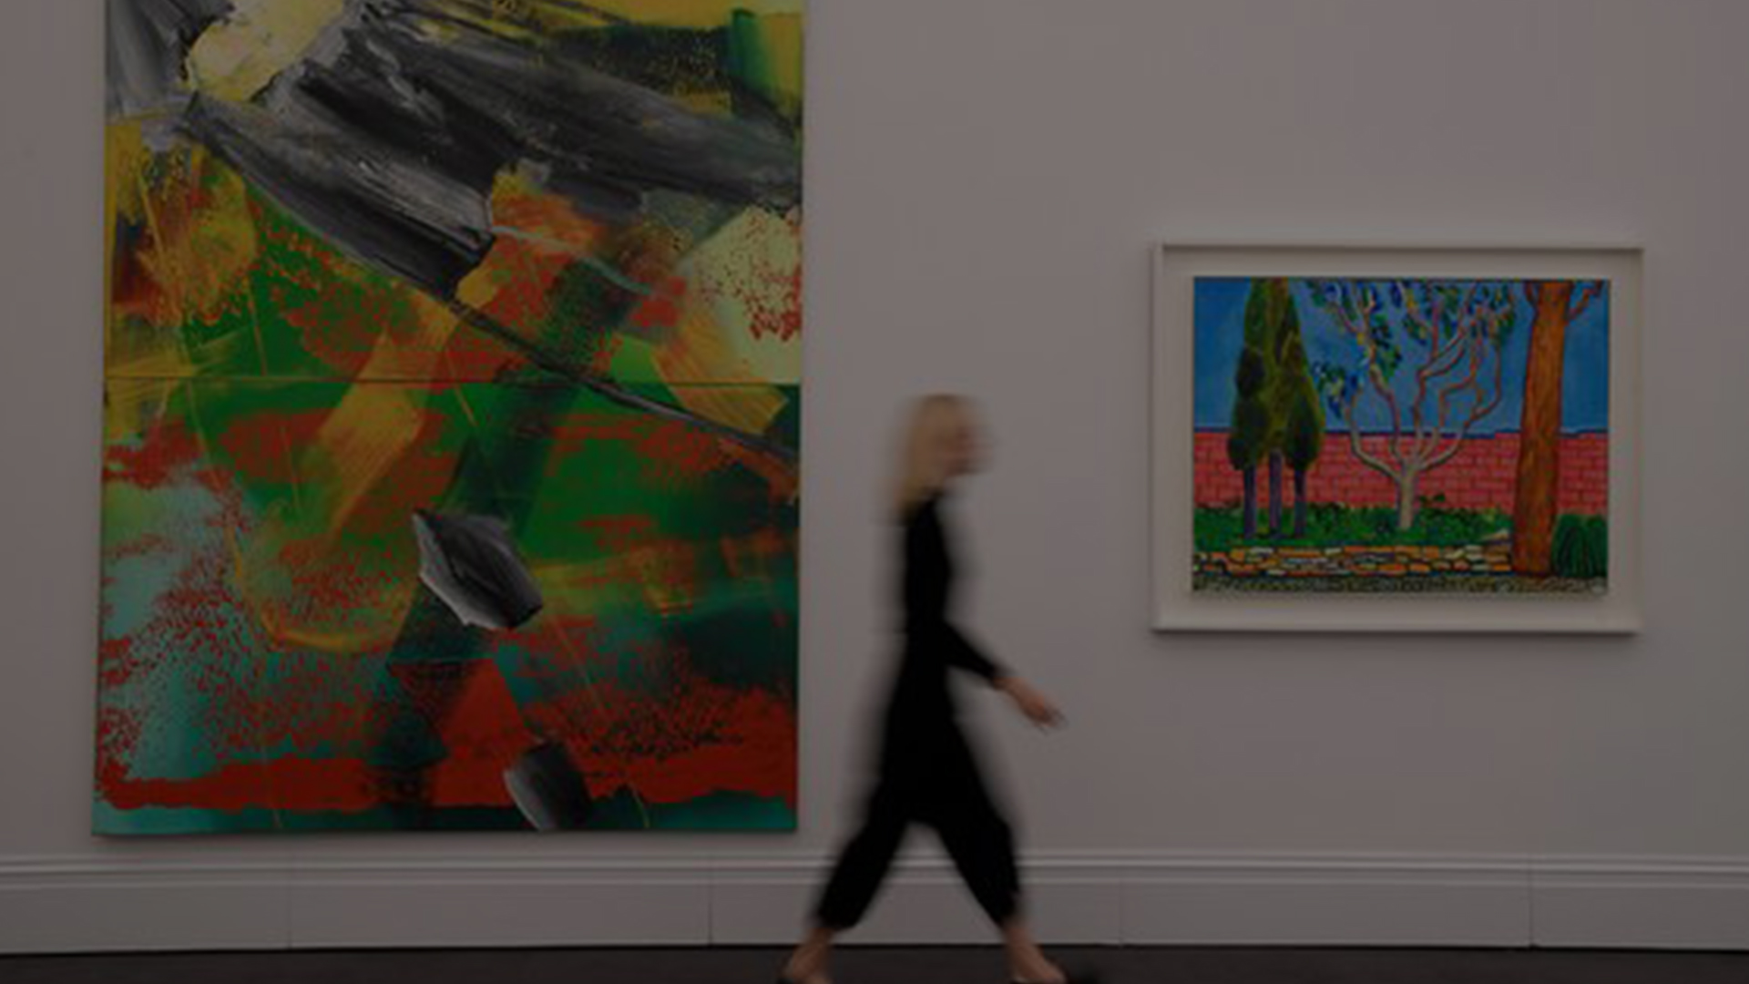
Art was the best return of investment for some due to an increase in flow of money on Wall Street

Slide 19
Art was the best return of investment for some due to an increase in flow of money on Wall Street
1980
NEO EXPRESSIONISM
NEO CONCEPTUALISM
ENVIONMENTAL ART
1981
MPMPHIS GROUP
THE INTRODUCTION OF PC
ART MARKET RISE
LAUNCH OF MTV
1982
EMOTICON
1983
3D PRINTER
WORLD WIDE WEB
1985
NINTENDO
DIGITAL DESIGN
1987
CULTURE WARS

Slide 20
MTV became an effective advertising medium because it uses music, visual elements, popular culture icons and the socializing effect of TV to drive its selling message.

Slide 21
MTV became an effective advertising medium because it uses music, visual elements, popular culture icons and the socializing effect of TV to drive its selling message.
1980
NEO EXPRESSIONISM
NEO CONCEPTUALISM
ENVIONMENTAL ART
1981
MPMPHIS GROUP
THE INTRODUCTION OF PC
ART MARKET RISE
LAUNCH OF MTV
1982
EMOTICON
1983
3D PRINTER
WORLD WIDE WEB
1985
NINTENDO
DIGITAL DESIGN
1987
CULTURE WARS

Slide 22
1980
1982
NEO EXPRESSIONISM
NEO CONCEPTUALISM
ENVIONMENTAL ART
1981
MPMPHIS GROUP
THE INTRODUCTION OF PC
ART MARKET RISE
LAUNCH OF MTV
1982
EMOTICON
1983
3D PRINTER
WORLD WIDE WEB
1985
NINTENDO
DIGITAL DESIGN
1987
CULTURE WARS

Slide 23
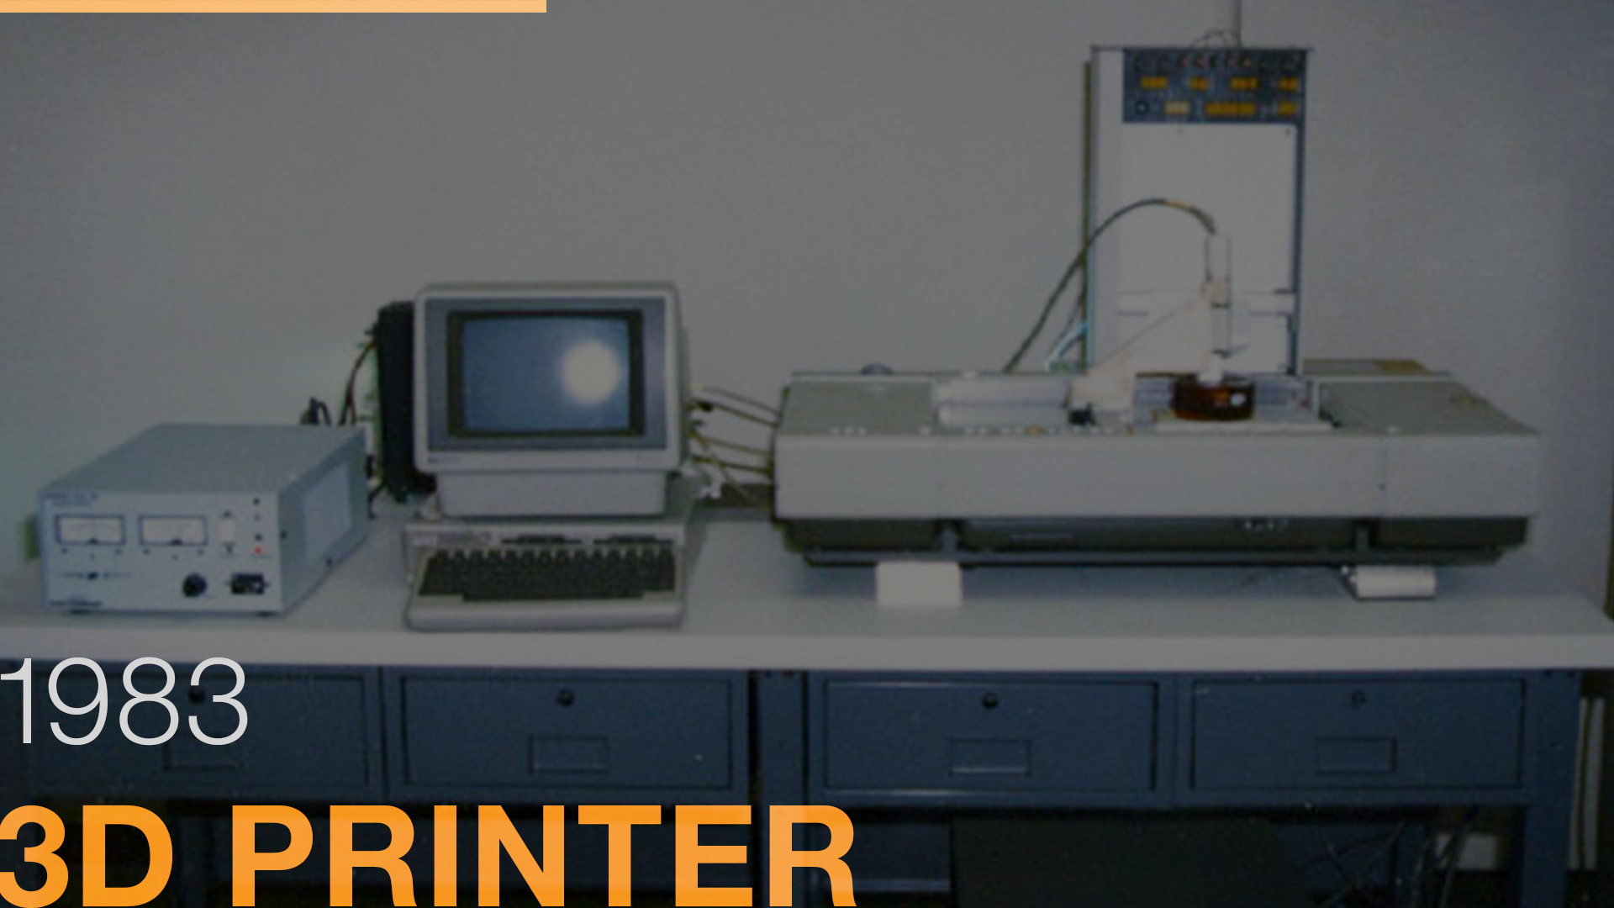
1980
NEO EXPRESSIONISM
NEO CONCEPTUALISM
ENVIONMENTAL ART
1981
MPMPHIS GROUP
THE INTRODUCTION OF PC
ART MARKET RISE
LAUNCH OF MTV
1982
EMOTICON
1983
3D PRINTER
WORLD WIDE WEB
1985
NINTENDO
DIGITAL DESIGN
1987
CULTURE WARS

Slide 24
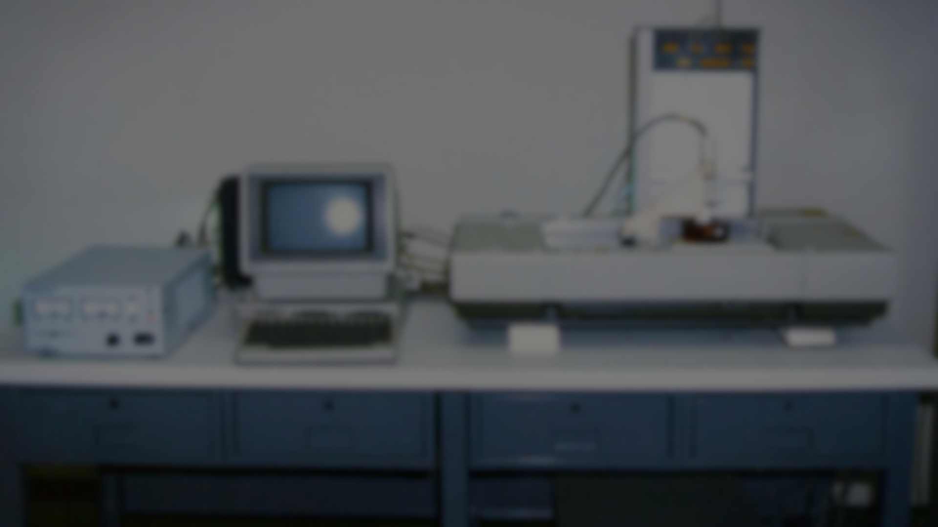
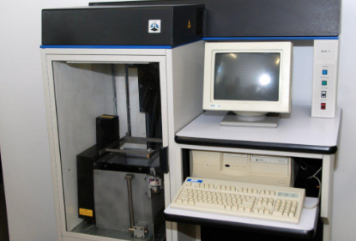
The rise in processor power and portability in the '80s meant companies that wanted to quickly build a prototype could start to do so entirely in-house.

Slide 25
The rise in processor power and portability in the '80s meant companies that wanted to quickly build a prototype could start to do so entirely in-house.
1980
NEO EXPRESSIONISM
NEO CONCEPTUALISM
ENVIONMENTAL ART
1981
MPMPHIS GROUP
THE INTRODUCTION OF PC
ART MARKET RISE
LAUNCH OF MTV
1982
EMOTICON
1983
3D PRINTER
WORLD WIDE WEB
1985
NINTENDO
DIGITAL DESIGN
1987
CULTURE WARS

Slide 26
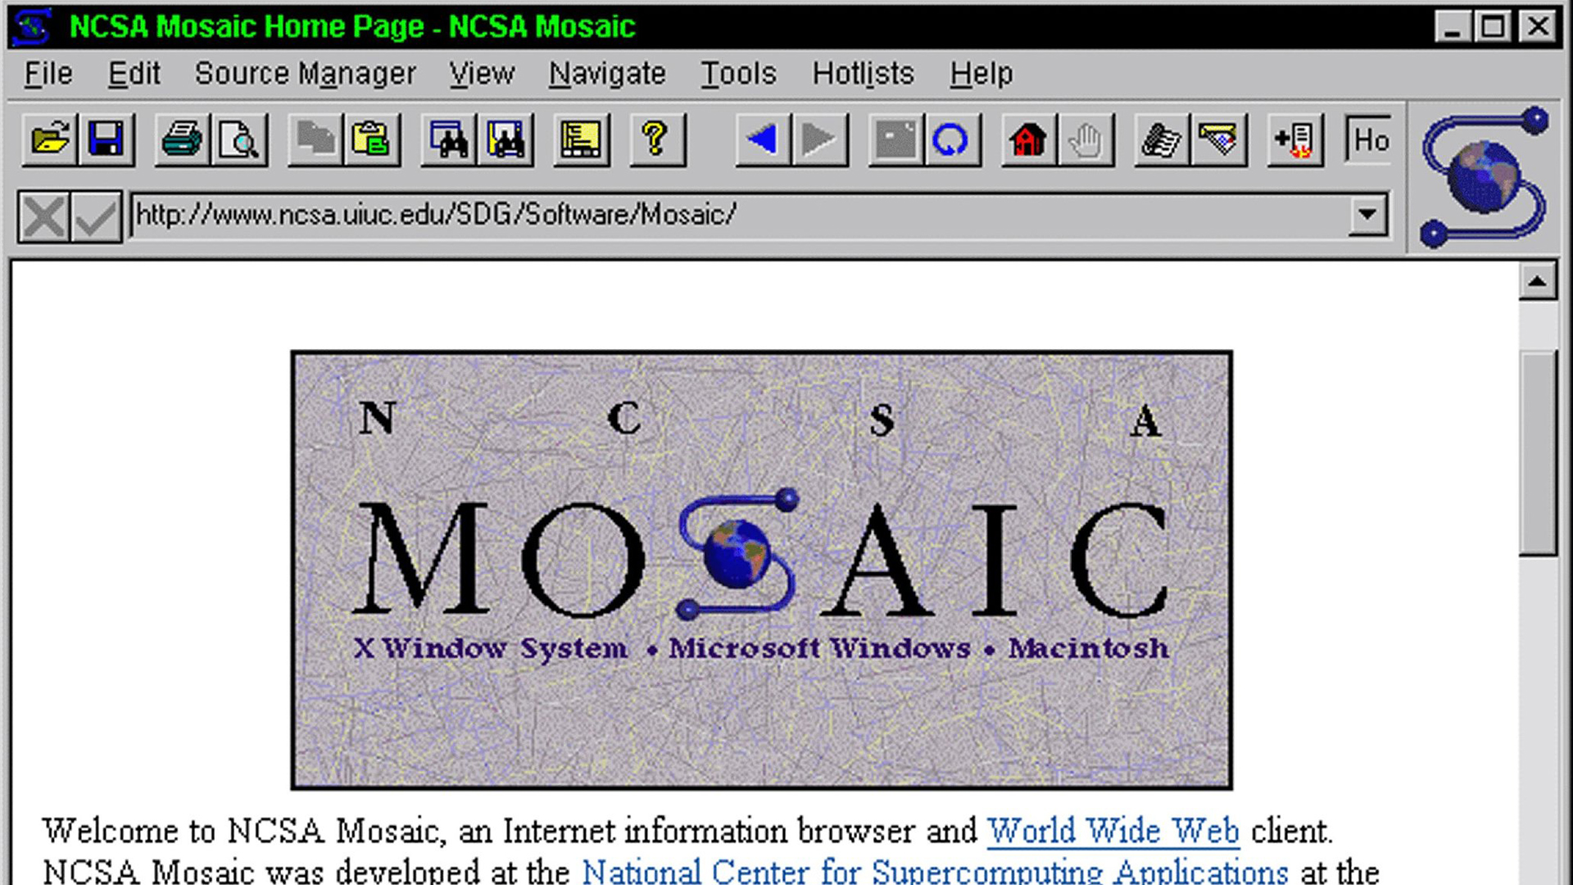
1980
NEO EXPRESSIONISM
NEO CONCEPTUALISM
ENVIONMENTAL ART
1981
MPMPHIS GROUP
THE INTRODUCTION OF PC
ART MARKET RISE
LAUNCH OF MTV
1982
EMOTICON
1983
3D PRINTER
WORLD WIDE WEB
1985
NINTENDO
DIGITAL DESIGN
1987
CULTURE WARS

Slide 27
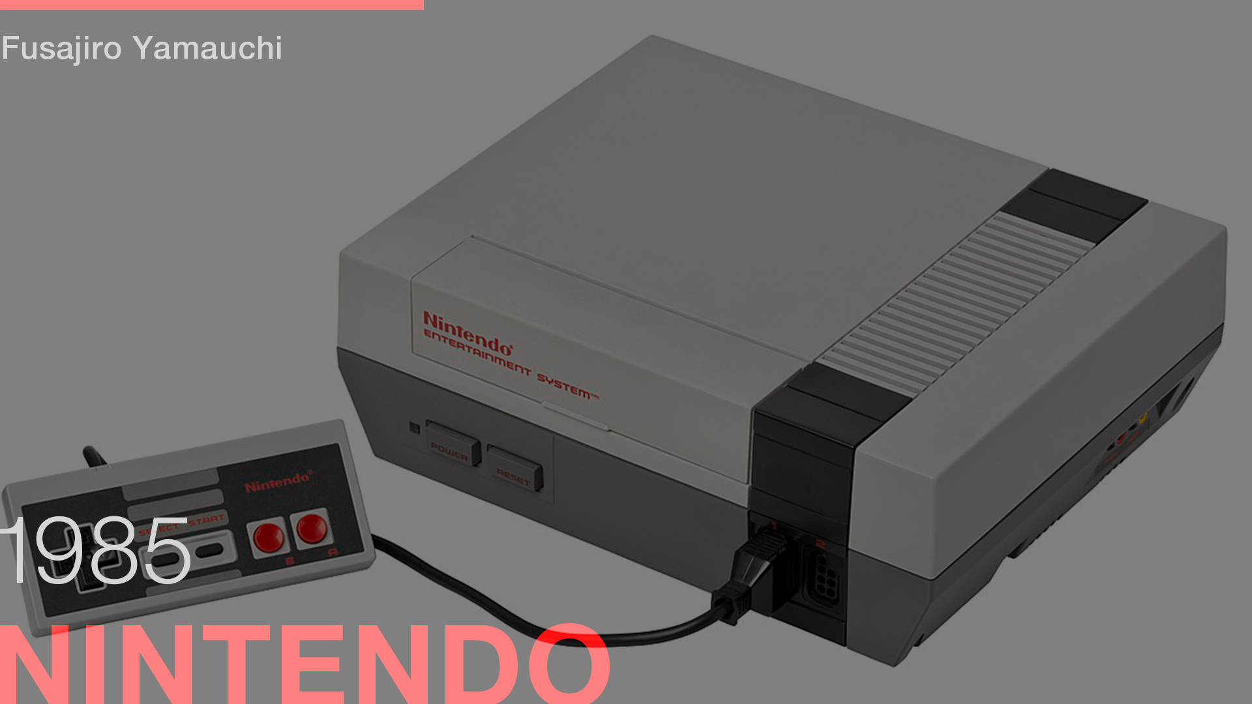
1980
NEO EXPRESSIONISM
NEO CONCEPTUALISM
ENVIONMENTAL ART
1981
MPMPHIS GROUP
THE INTRODUCTION OF PC
ART MARKET RISE
LAUNCH OF MTV
1982
EMOTICON
1983
3D PRINTER
WORLD WIDE WEB
1985
NINTENDO
DIGITAL DESIGN
1987
CULTURE WARS

Slide 28
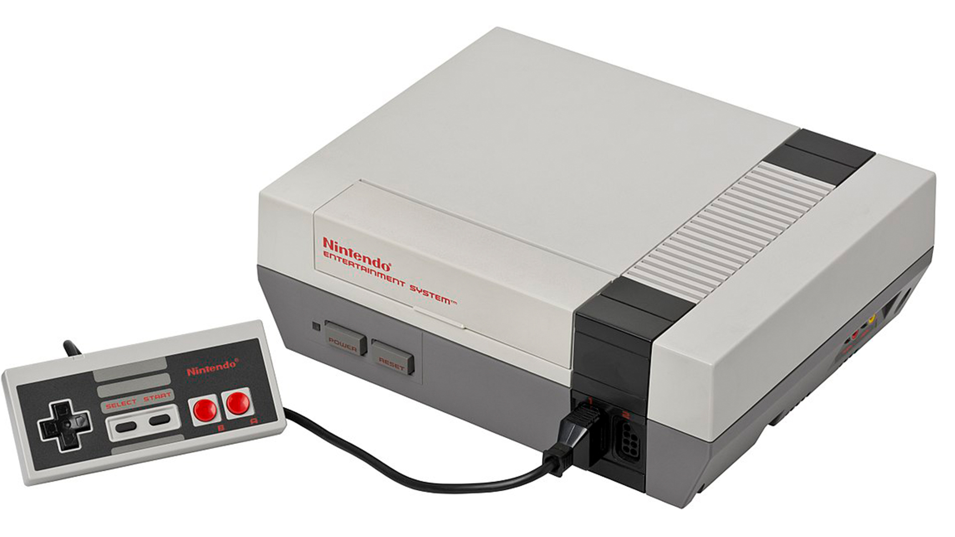
“Famicom”

Slide 29
“Famicom”

Slide 30
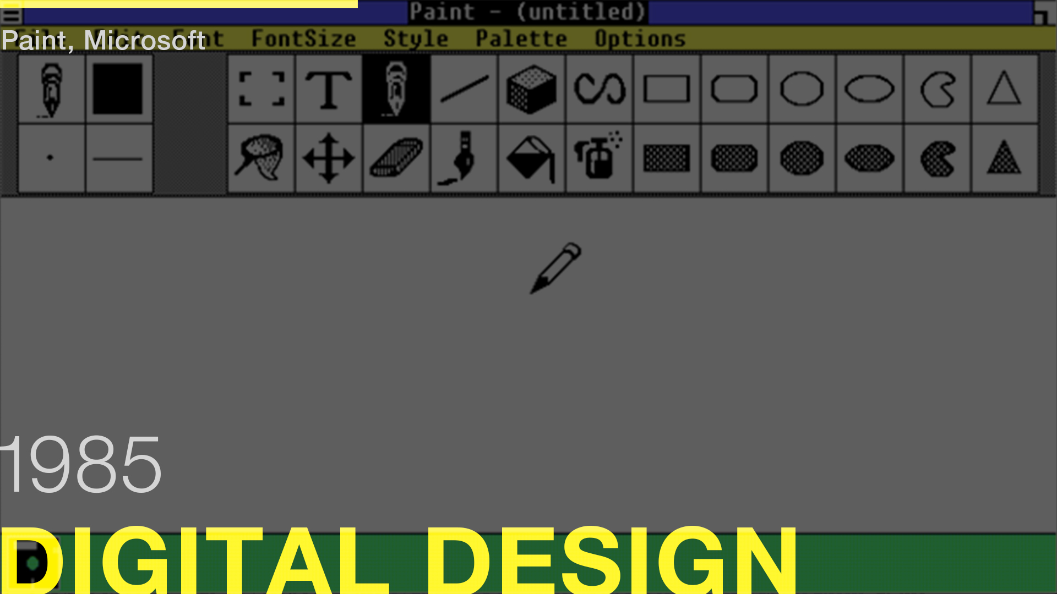
1980
NEO EXPRESSIONISM
NEO CONCEPTUALISM
ENVIONMENTAL ART
1981
MPMPHIS GROUP
THE INTRODUCTION OF PC
ART MARKET RISE
LAUNCH OF MTV
1982
EMOTICON
1983
3D PRINTER
WORLD WIDE WEB
1985
NINTENDO
DIGITAL DESIGN
1987
CULTURE WARS

Slide 31
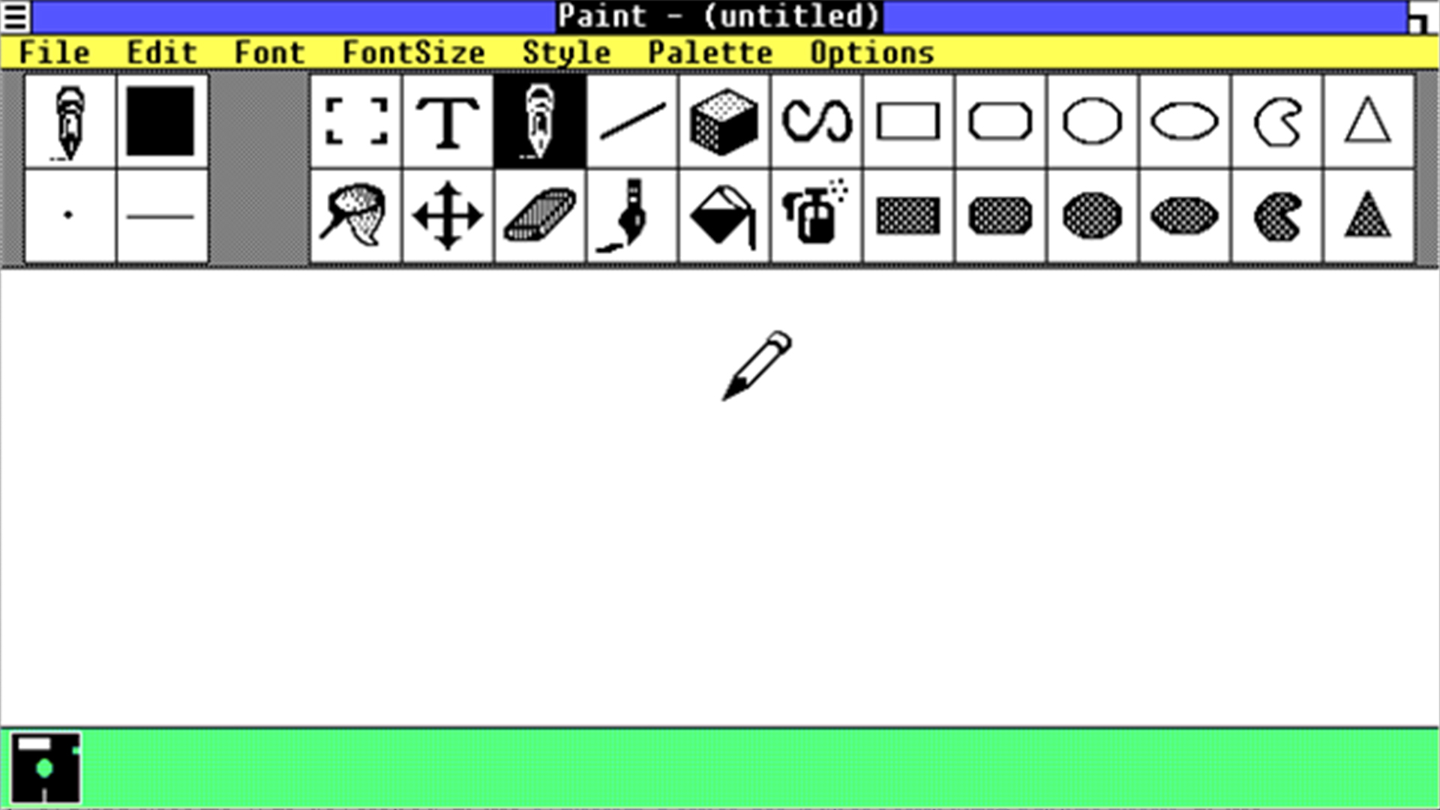

Slide 32
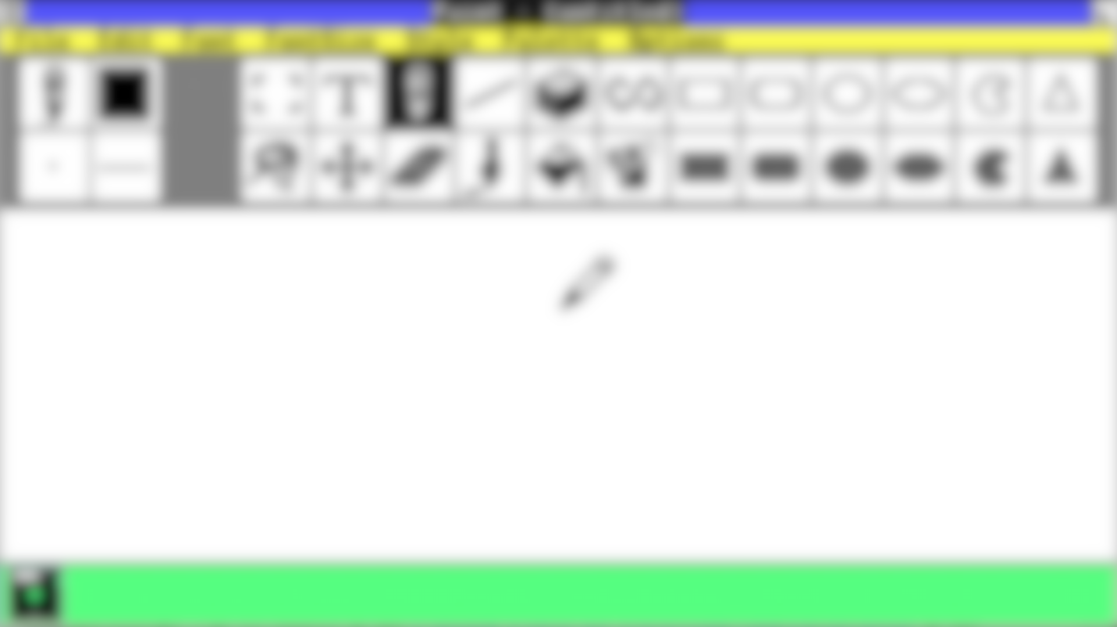
No longer need to create designs by hand, resulting in more polished designs.

Slide 33
No longer need to create designs by hand, resulting in more polished designs.
1980
NEO EXPRESSIONISM
NEO CONCEPTUALISM
ENVIONMENTAL ART
1981
MPMPHIS GROUP
THE INTRODUCTION OF PC
ART MARKET RISE
LAUNCH OF MTV
1982
EMOTICON
1983
3D PRINTER
WORLD WIDE WEB
1985
NINTENDO
DIGITAL DESIGN
1987
CULTURE WARS

Slide 35
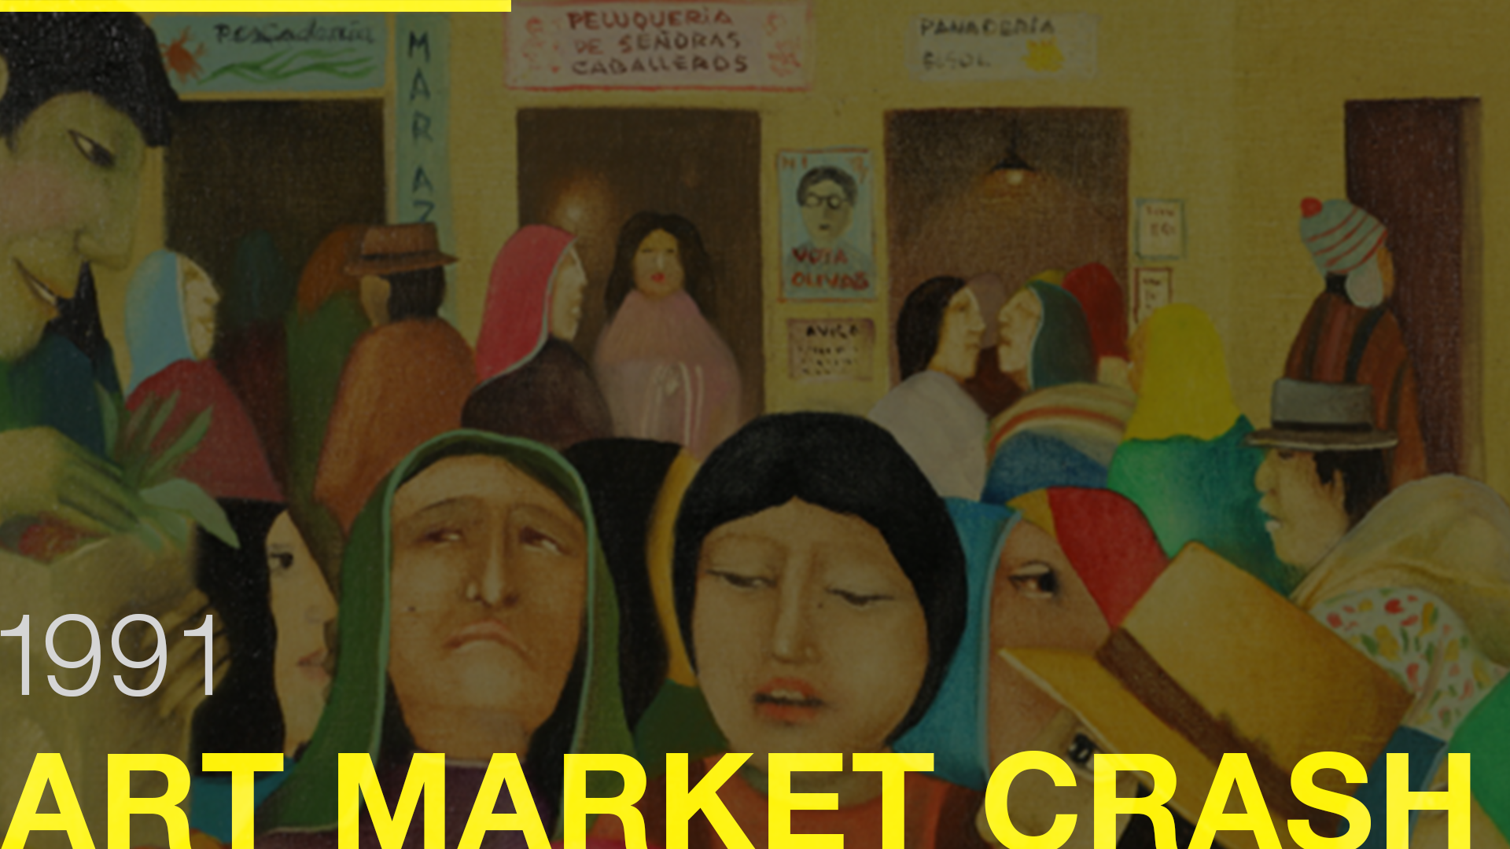
1991
ART MARKET CRASH
IDENTITY POLITICS
1992
SEX IDENTICAL
CRISIS
1993
DEATH OF
PANTINGS
1994
SONY PS
CONSOLE
1995
SUBCULTURES
1997
RELATIONAL
AESTHETICS
1998
CELEBRITY
CULTURES

Slide 36
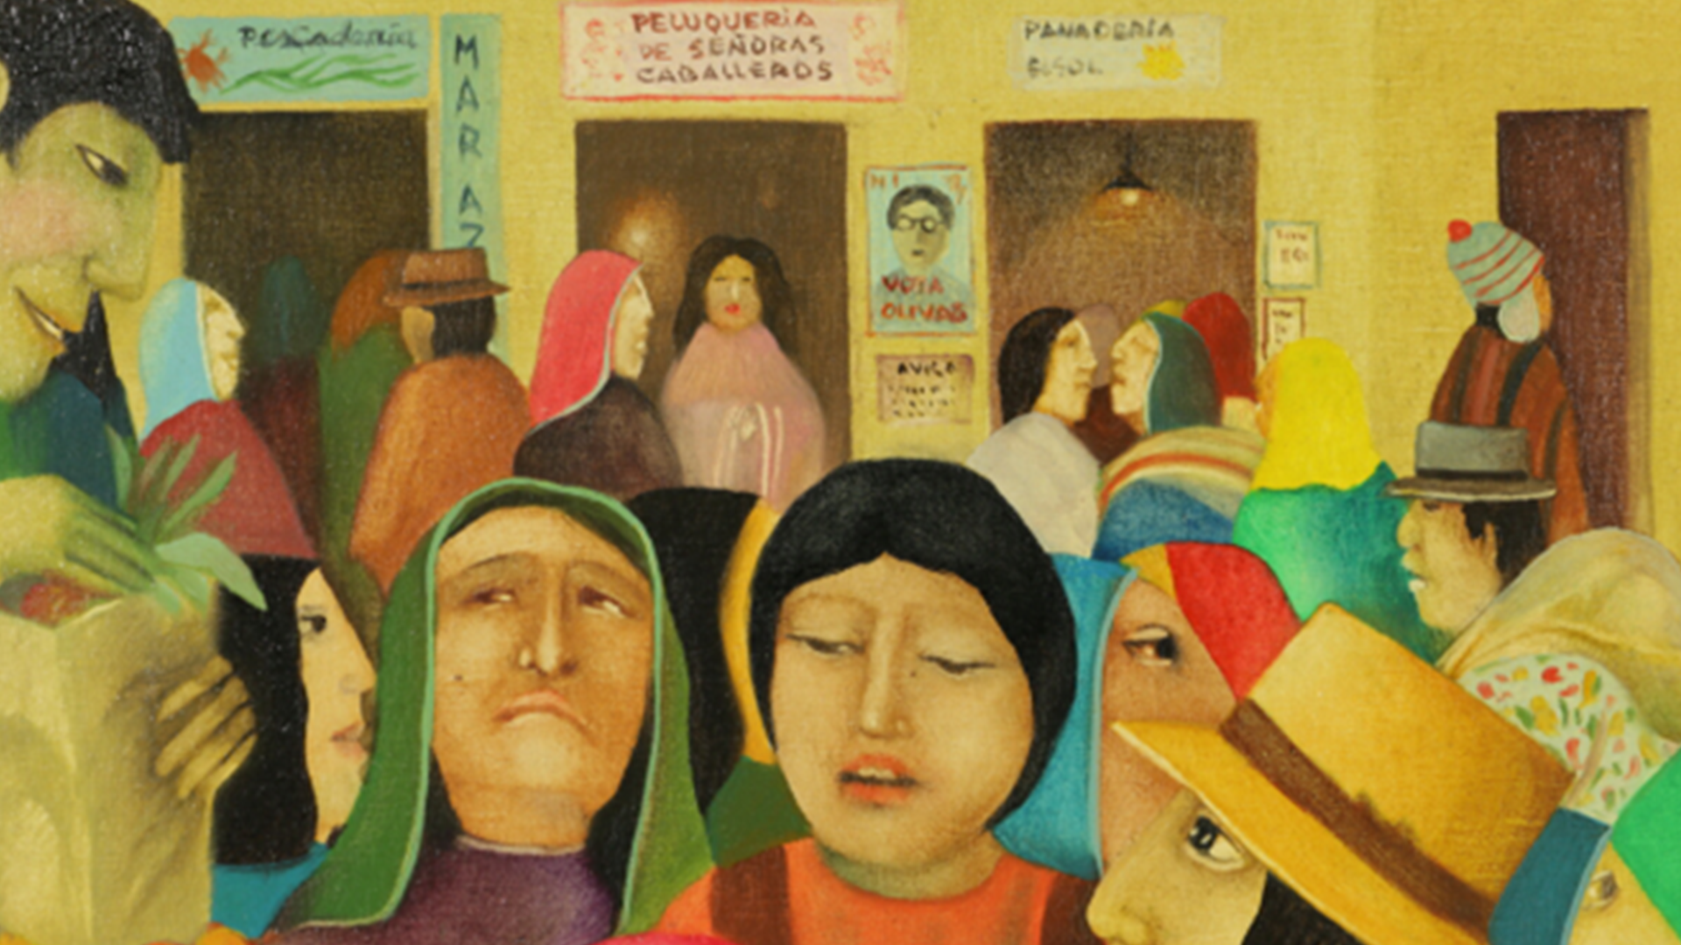
People started to rethink the value in art and things started to revolve around conservationism.

Slide 37
People started to rethink the value in art and things started to revolve around conservationism.
1991
ART MARKET CRASH
IDENTITY POLITICS
1992
SEXUAL IDENTITY
CRISIS
1993
DEATH OF
PANTINGS
1994
SONY PS
CONSOLE
1995
SUBCULTURES
1997
RELATIONAL
AESTHETICS
1998
CELEBRITY
CULTURES

Slide 38
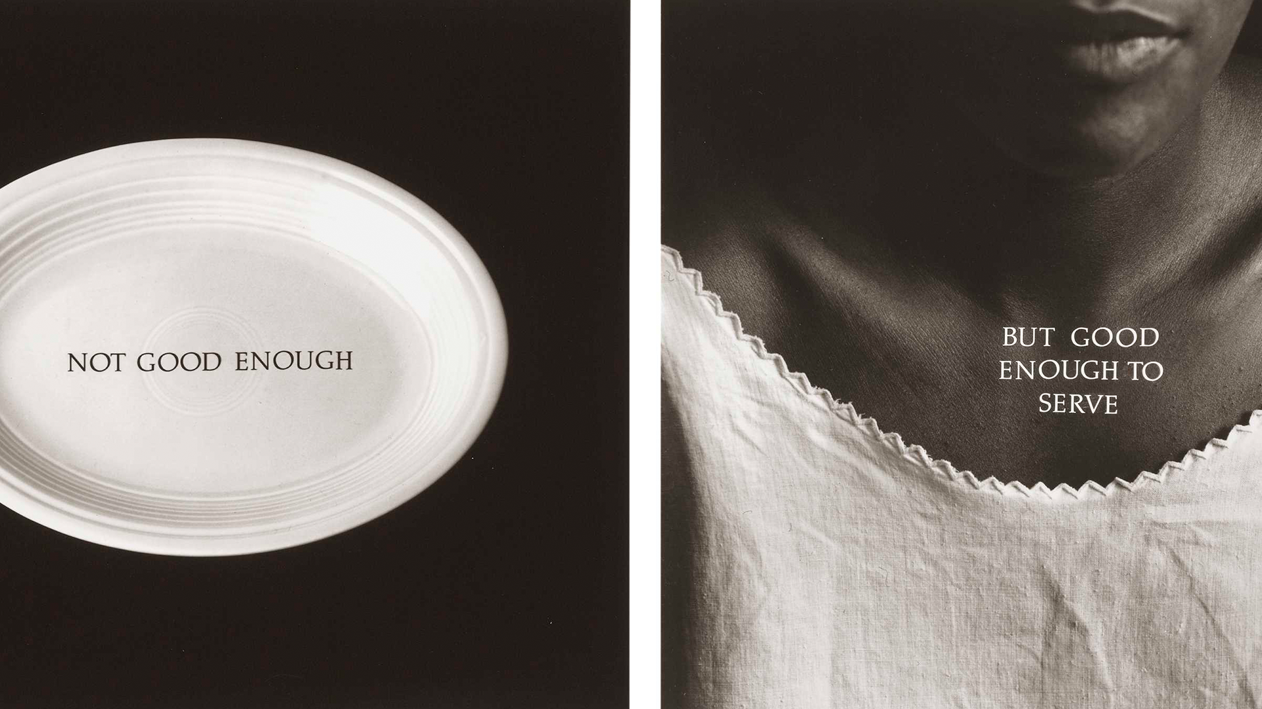

Slide 39
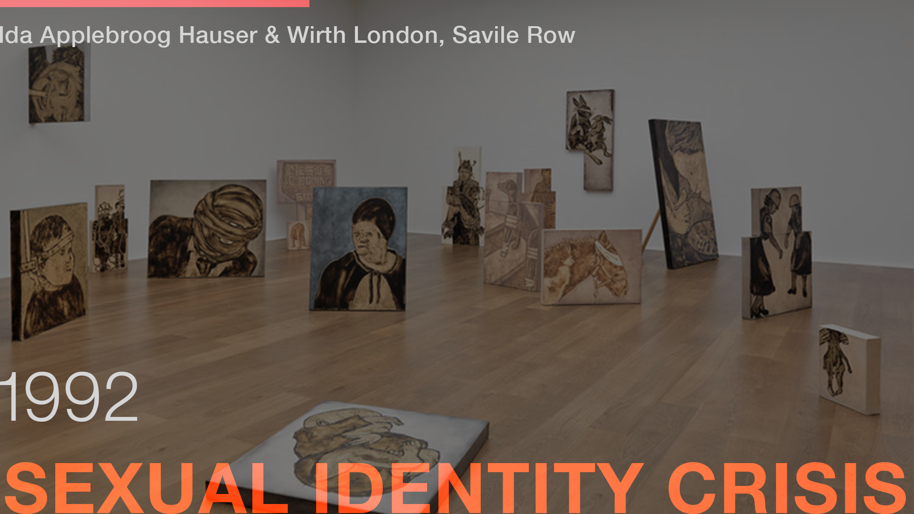
1991
ART MARKET CRASH
IDENTITY POLITICS
1992
SEXUAL IDENTITY
CRISIS
1993
DEATH OF
PANTINGS
1994
SONY PS
CONSOLE
1995
SUBCULTURES
1997
RELATIONAL
AESTHETICS
1998
CELEBRITY
CULTURES

Slide 40
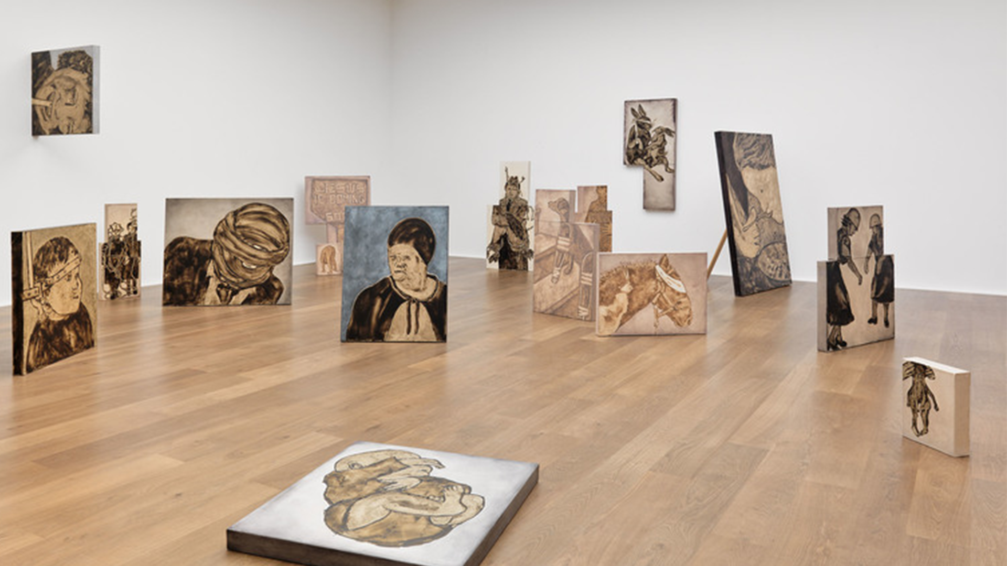

Slide 41
1991
ART MARKET CRASH
IDENTITY POLITICS
1992
SEXUAL IDENTITY
CRISIS
1993
DEATH OF
PANTINGS
1994
SONY PS
CONSOLE
1995
SUBCULTURES
1997
RELATIONAL
AESTHETICS
1998
CELEBRITY
CULTURES

Slide 42
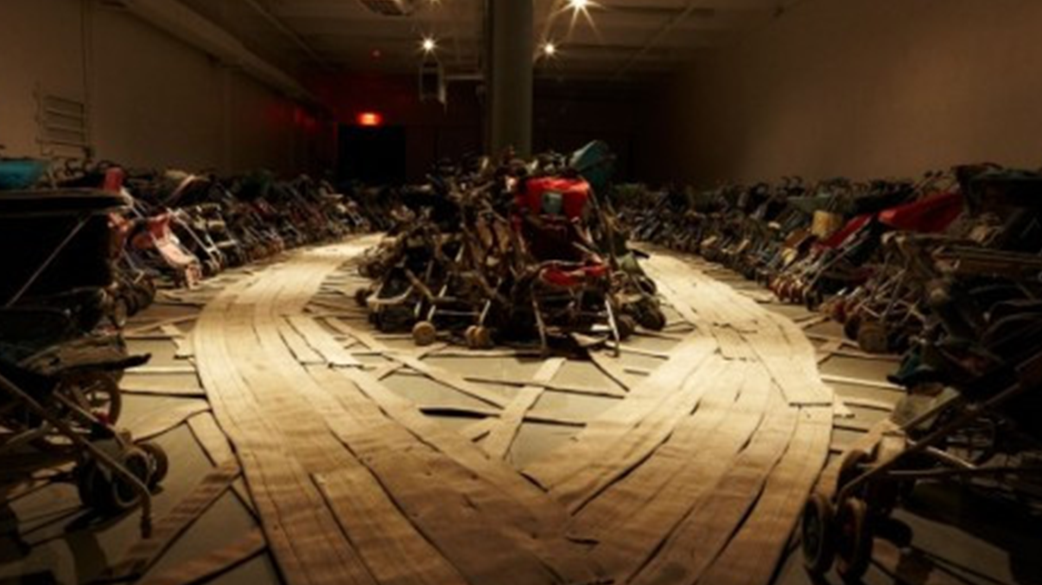

Slide 43
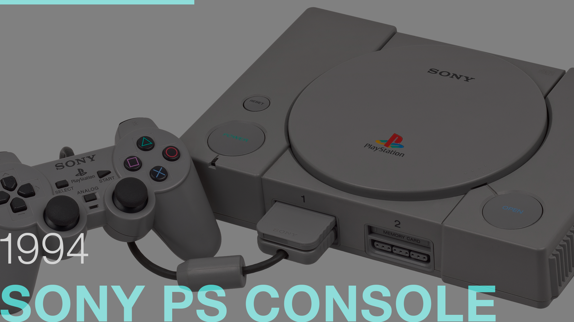
1991
ART MARKET CRASH
IDENTITY POLITICS
1992
SEXUAL IDENTITY
CRISIS
1993
DEATH OF
PANTINGS
1994
SONY PS
CONSOLE
1995
SUBCULTURES
1997
RELATIONAL
AESTHETICS
1998
CELEBRITY
CULTURES

Slide 44
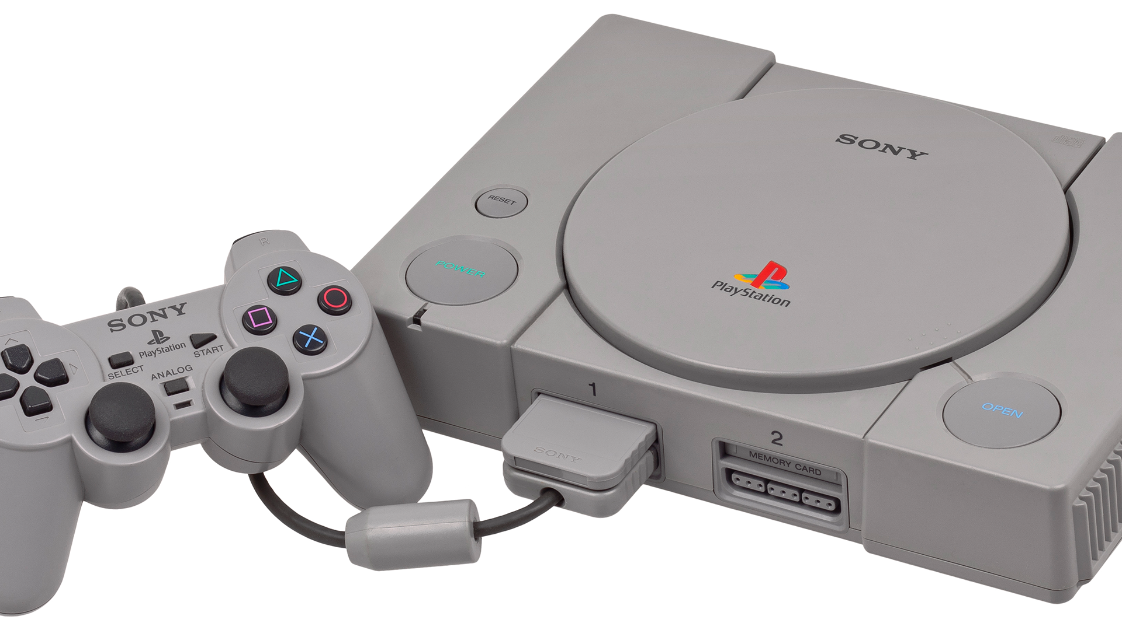

Slide 45
1991
ART MARKET CRASH
IDENTITY POLITICS
1992
SEXUAL IDENTITY
CRISIS
1993
DEATH OF
PANTINGS
1994
SONY PS
CONSOLE
1995
SUBCULTURES
1997
RELATIONAL
AESTHETICS
1998
CELEBRITY
CULTURES

Slide 46
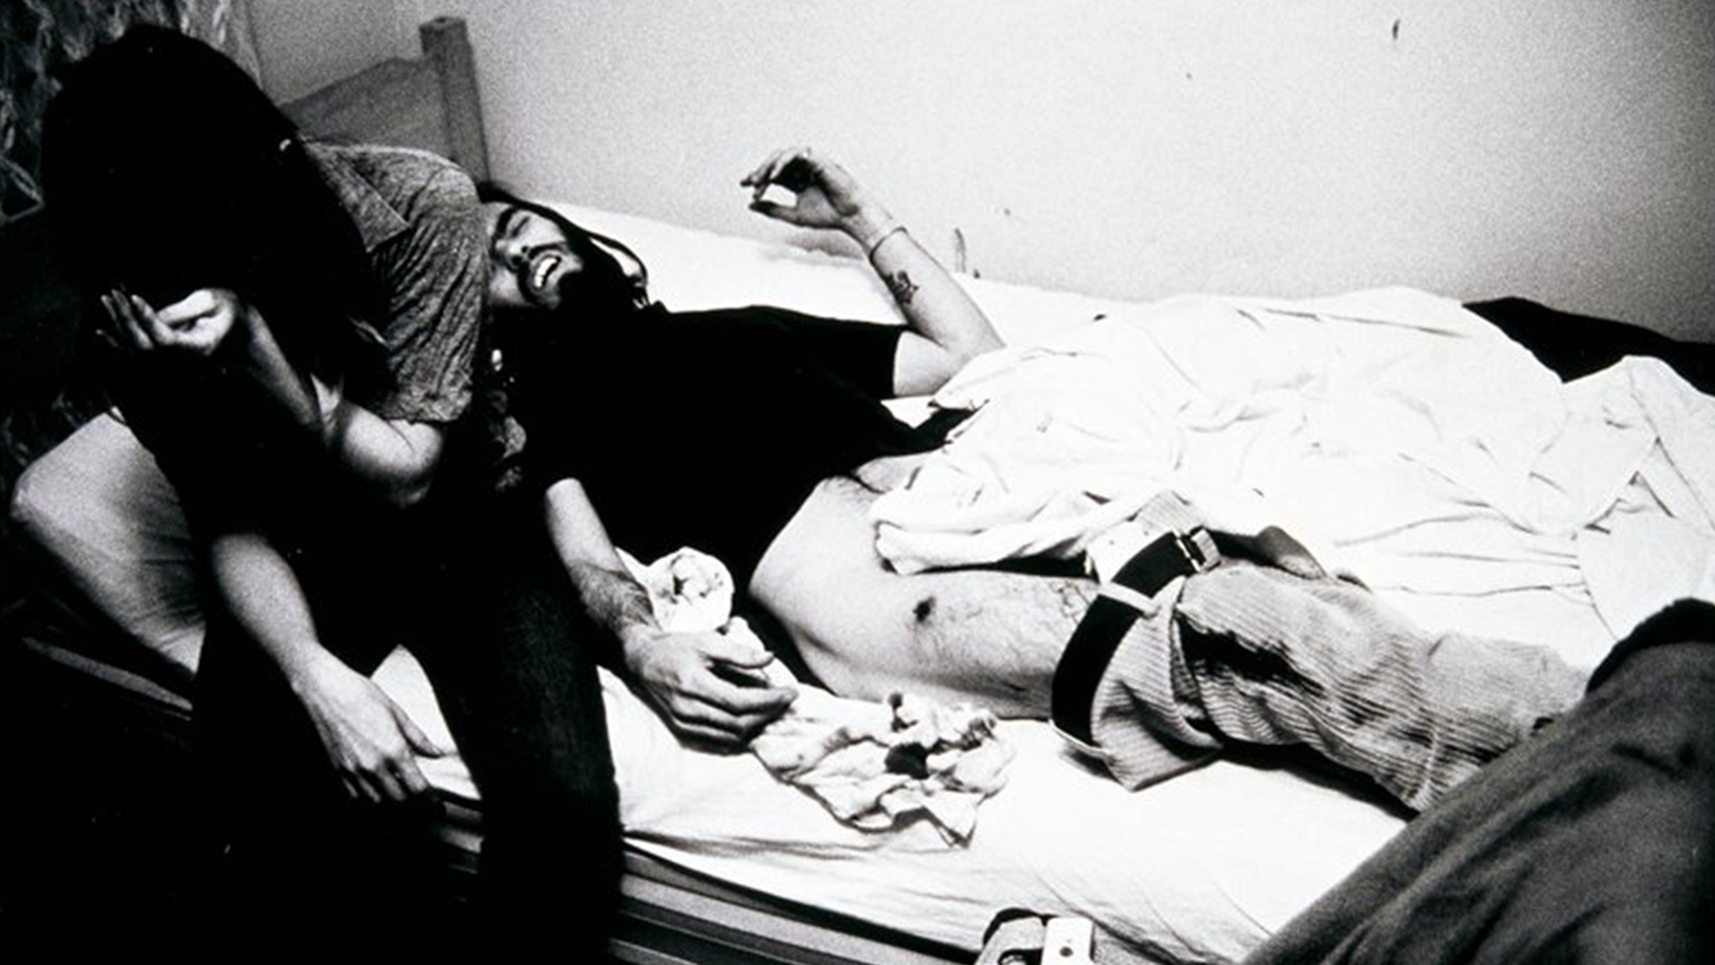
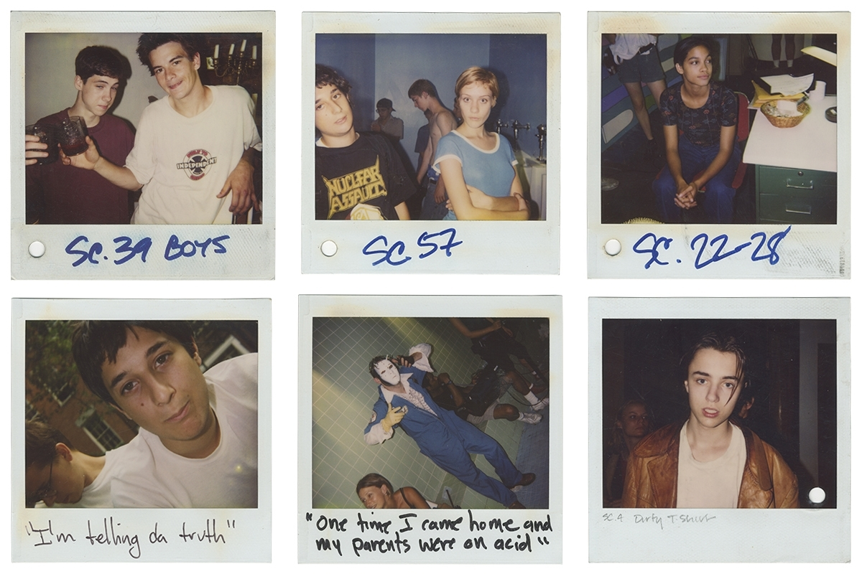
Larry Clark's photographs and films started to prompt discussions about the younger generation that often disregarded societal norms.

Slide 47
Larry Clark's photographs and films started to prompt discussions about the younger generation that often disregarded societal norms.
1991
ART MARKET CRASH
IDENTITY POLITICS
1992
SEXUAL IDENTITY
CRISIS
1993
DEATH OF
PANTINGS
1994
SONY PS
CONSOLE
1995
SUBCULTURES
1997
RELATIONAL
AESTHETICS
1998
CELEBRITY
CULTURES

Slide 49
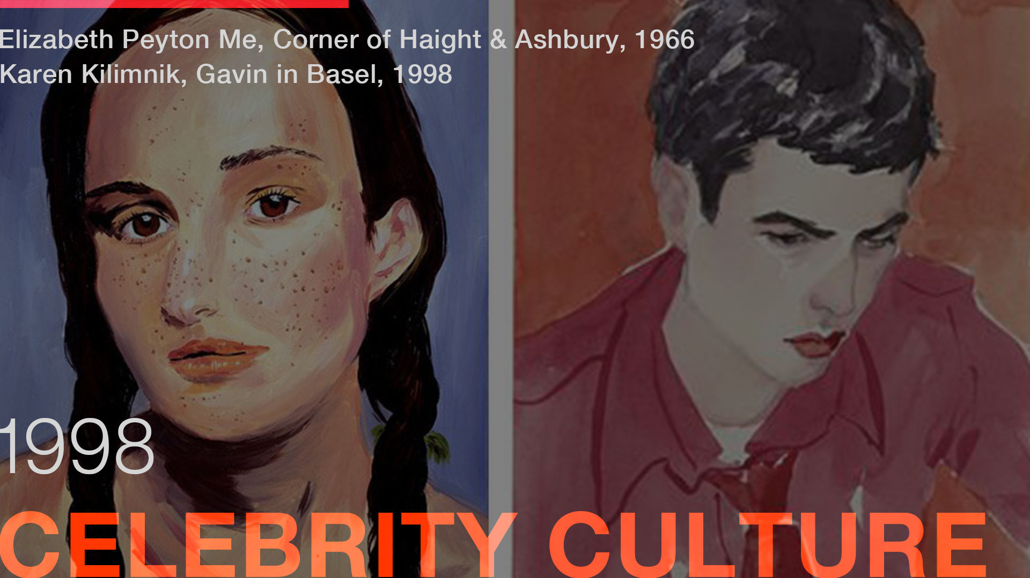
1991
ART MARKET CRASH
IDENTITY POLITICS
1992
SEXUAL IDENTITY
CRISIS
1993
DEATH OF
PANTINGS
1994
SONY PS
CONSOLE
1995
SUBCULTURES
1997
RELATIONAL
AESTHETICS
1998
CELEBRITY
CULTURES

Slide 50
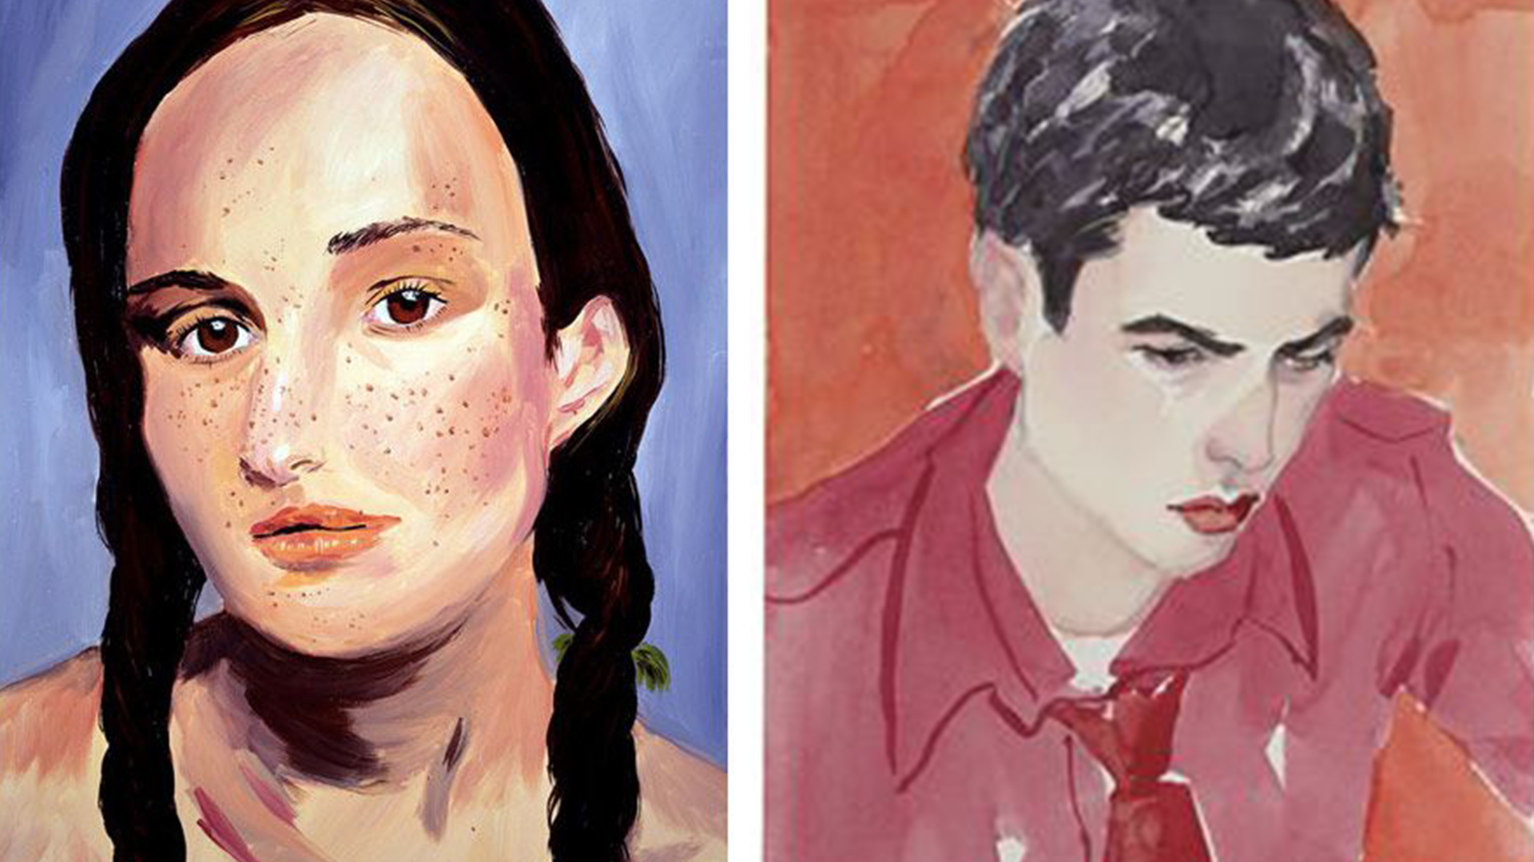

Slide 51
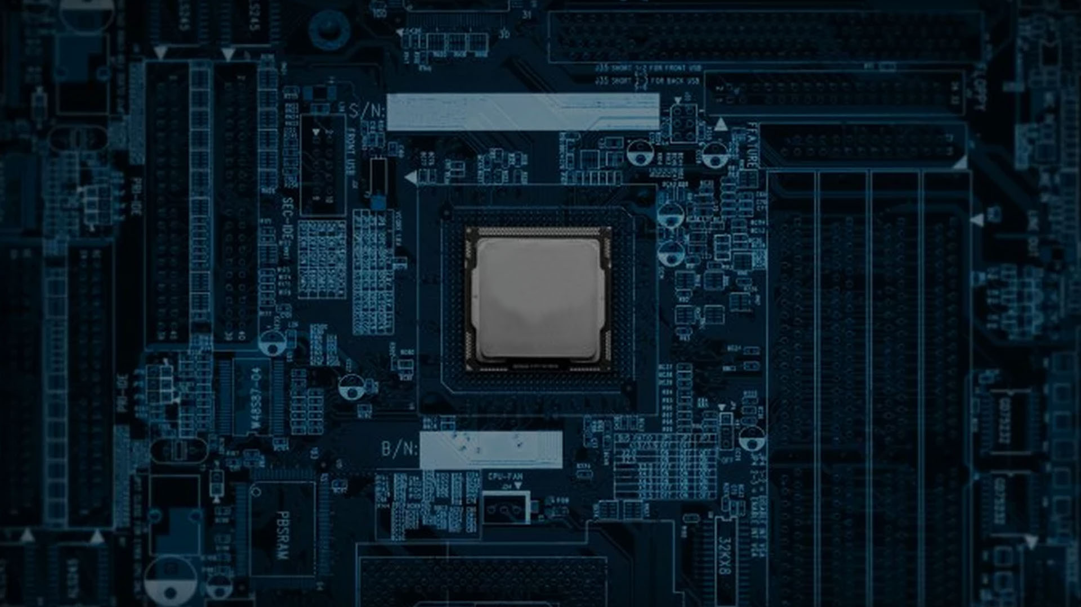
1980-1990:
WIRED https://www.wired.com/2012/12/the-decades-that-invented-the-future-part-8-1981-1990/
THE NEW YORK TIMEShttps://www.nytimes.com/1990/12/16/business/the-art-boom-is-it-over-or-is-this-just-a-correction.html
3DINSIDER https://3dinsider.com/3d-printing-history/
ADAGE https://adage.com/article/adage-encyclopedia/mtv-influence/99328/
THE ART STORY https://www.theartstory.org/movement-neo-expressionism.htm
1983 TIMELINES https://1983timeline.wordpress.com/2013/10/06/art-movements-of-the-1980s/
HISTORY GRAPHIC DESIGN http://www.historygraphicdesign.com/the-age-of-information/postmodern-design/792-memphis
THE ARTIST https://the-artists.org/neo-conceptualism/
1990-2000:
DESIGN.TUTSPLUS.COM https://design.tutsplus.com/articles/10-decades-of-design--cms-29370
BBC http://www.bbc.com/culture/story/20150205-the-1990s-never-ended
ARTSPACE https://www.artspace.com/magazine/art_101/art_market/the_art_world_in_the_90s-5912
ACTUPNY http://www.actupny.org/reports/silencedeath.html
MOMARDI http://momardi.com/the-uncanny-and-ida-applebroog-at-hauser-wirth/
WIRED https://www.wired.com/2013/01/the-decades-that-invented-the-future-part-10-1991-2000/
Sources

Slide 52
Belinda Chang
research(1990-2000), present
Haena Lee
design(1980-1990), present
Ming-Hui Lin
design(1990-2000), present
Senjal Pandharpatte
research(1980-1990), present
Credit

